Slide 1

Object Oriented Programming Using
[ES203]
Dr. Juhi Singh
Notes:
Amity Business School

Slide 2
Friend Function & Class

Slide 3
Friend functions
When we want to classes to share function.
A friend function is a function that can access the private members of a class as though it were a member of that class.
To declare a function as a friend of a class, precede the function prototype in the class definition with the keyword friend.
To make a function as a friend of a class, it is declared prototype inside the class either in private or in public section with keyword friend.

Slide 4
Can be invoked like a normal function without the help of an object.
Can be declared either in ublic or private mode without affecting its meaning.
Usually it has objects as arguements

Slide 5
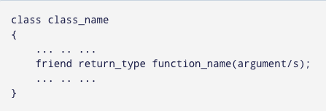
Declaration of friend function in C++
We can define the friend function as a normal function to access the data of the class.

Slide 6
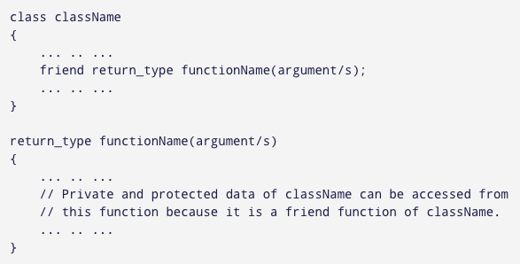
Declaration of friend function in C++
No friend keyword is used in the definition.

Slide 7
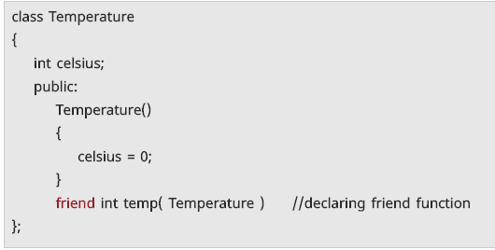
Example of Declaration of Friend Function:

Slide 8
There are some points to remember while implementing friend functions in our program:
A friend function can be declared in the private or public section of the class.
It can be called like a normal function without using the object.
A friend function is not in the scope of the class, of which it is a friend.
A friend function is not invoked using the class object as it is not in the scope of the class.
A friend function cannot access the private and protected data members of the class directly. It needs to make use of a class object and then access the members using the dot operator.
A friend function can be a global function or a member of another class.

Slide 9
class sample{
int length, width;
public:
sample(int len, int bre){
length=len, width =bre; }
friend void calcArea(sample s); //friend function declaration
};
//friend function definition
void calcArea(sample s){
cout<<"Area = "<<s.length * s. width;
}
int main()
{ sample s1(10,15);
calcArea(s1);
return 0;
}

Slide 10
class Box {
double width;
public:
void setWidth( double wid );
friend void printWidth( Box box ); };
void Box::setWidth( double wid ) { width = wid; }
// Note: printWidth() is not a member function of any class.
void printWidth( Box box )
{
/* Because printWidth() is a friend of Box, it can directly access any member of this class */
cout << "Width of box : " << box.width <<endl;
}

Slide 11
int main( )
{
Box box;
// set box width without member function box.setWidth(10.0);
// Use friend function to print the wdith. printWidth( box );
return 0; }

Slide 12
Other example
#include <iostream>
using namespace std;
class XYZ
{
private: int num=100; char ch='Z';
public: friend void disp(XYZ obj);
};
Void disp(XYZ obj)
{
cout<<obj.num<<endl; cout<<obj.ch<<endl;
}
int main()
{
XYZ obj; disp(obj); return 0;
}

Slide 13
Friend Class
Friend class can access private and protected members of the class to which it is a friend.

Slide 14
class A{
……
friend class B;
};
class B
{ ……..
};
B is a friend of class A. So class B can access the private and protected members of class A.
But this does not mean that class A can access private and protected members of the class B. Note that the friendship is not mutual unless we make it so.

Slide 15
#include <iostream>
using namespace std;
class XYZ
{
private: char ch='A';
int num = 11;
public:
Int a;
friend class ABC;
};
class ABC
{
public: void disp(XYZ obj)
{ cout<<obj.ch<<endl; cout<<obj.num<<endl;
}
};
int main()
{
ABC obj; XYZ obj2; obj.disp(obj2);
return 0; }

Slide 16
Friend Class
using namespace std;
class Area{
int length , breadth , area;
public:
Area(int len, int bre)
{
length=len;breadth=bre;
}
void calcArea(){
area = length * breadth;
}
friend class printClass;
};
class printClass{
public:
void printArea(Area a){
cout<<"Area = "<<a.area;
}
};
int main(){
Area a(10,15);
a.calcArea();
printClass p;
p.printArea(a);
return 0;
}

Slide 17
Addition of private members of two different classes using friend Function
#include <iostream>
using namespace std;
class B;
class A {
private:
int numA;
public:
A(){ numA=12;} friend int add(A, B);
};
class B {
private:
int numB;
public:
B(): numB(1) { }
friend int add(A , B);
};
int add(A objectA1, B objectB1)
{
return (objectA1.numA + objectB1.numB);
}

Slide 18
int main()
{
A objectA;
B objectB;
cout<<"Sum: "<< add(objectA, objectB);
return 0;
}

Slide 19
Properties of Friend Function
Friend of the class can be member of some other class.
Friend of one class can be friend of another class or all the classes in one program, such a friend is known as GLOBAL FRIEND.
Friend can access the private or protected members of the class in which they are declared to be friend, but they can use the members for a specific object.
Friends are non-members hence do not get “this” pointer.
Friends, can be friend of more than one class, hence they can be used for message passing between the classes.
Friend can be declared anywhere (in public, protected or private section) in the class.

Slide 20
Array of Objects
Like array of other user-defined data types, an array of type class can also be created.
The array of type class contains the objects of the class as its individual elements.
Thus, an array of a class type is also known as an array of objects.
An array of objects is declared in the same way as an array of any built-in data type.
Syntax:
class_name array_name [size] ;

Slide 21
Array of Objects
#include <iostream> class MyClass { int x; public: void setX(int i) { x = i; } int getX() { return x; } }; | void main() { MyClass obs[4]; int i; for(i=0; i < 4; i++) {obs[i].setX(i); } for(i=0; i < 4; i++) { cout << "obs[" << i << "].getX(): " << obs[i].getX() << "\n"; } getch(); }
Output
obs[0].getX(): 0
obs[1].getX(): 1
obs[2].getX(): 2
obs[3].getX(): 3

Slide 22
#include<iostream.h>
#include<conio.h>
class Employee
{ int Id; char Name[25];
int Age; long Salary;
public: void GetData() //Statement 1 : Defining GetData()
{
cout<<"\n\tEnter Employee Id : ";
cin>>Id; cout<<"\n\tEnter Employee Name : ";
cin>>Name; cout<<"\n\tEnter Employee Age : ";
cin>>Age;
cout<<"\n\tEnter Employee Salary : ";
cin>>Salary;
}
void PutData() //Statement 2 : Defining PutData()
{
cout<<"\n"<<Id<<"\t"<<Name<<"\t"<<Age<<"\t"<<Salary;
} };

Slide 23
void main() { int i;
Employee E[3];
//Statement 3 : Creating Array of 3 Employees
for(i=0;i<3;i++)
{ cout<<"\nEnter details of "<<i+1<<" Employee";
E[i].GetData();
}
cout<<"\nDetails of Employees";
for(i=0;i<3;i++) E[i].PutData();
}

Slide 24
Constant Member functions and Objects
const objects require const functions
  Member functions declared const cannot modify their object
  const must be specified in function prototype and definition
  Prototype:
      ReturnType FunctionName(param1,param2…) const;
  Definition:
      ReturnType FunctionName(param1,param2…) const { …}
  Example:
      int A::getValue() const { return
      private DataMember };
    Returns the value of a data member but doesn’t modify anything so is declared const
Constructors / Destructors cannot be const
  They need to initialize variables, therefore modifying them

Slide 25
Constant Member functions
The const member functions are the functions which are declared as constant in the program.
The object called by these functions cannot be modified.
It is recommended to use const keyword so that accidental changes to object are avoided.
A const member function can be called by any type of object. Non-const functions can be called by non-const objects only. syntax
datatype function_name const ();

Slide 26
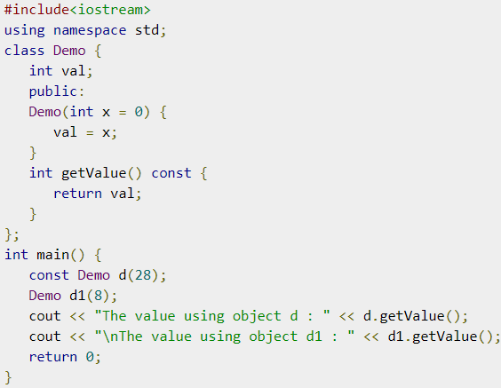
Constant Member functions
Output
The value using object d : 28
The value using object d1 : 8

Slide 27
Thank You

